Slide 1
CSX4109 / ITX4109
ANDROID APPLICATION DEVELOPMENT

Slide 2
CONSTRAINT LAYOUT

Slide 3
HOW TO ACHIEVE THIS?

Slide 4
LAYOUT IDEA
@Composable
fun SimpleLayout() {
Row {
for (count in 1..4) {
Column {
Text { ... }
Text { ... }
}
}
}
}

Slide 5
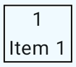
START WITH THE ITEM
@Composable
fun SimpleItem(count: Int) {
Column(modifier = Modifier.padding(start = 16.dp, end = 16.dp)
.border(width = 1.dp, color = Color.Black)) {
Text(count.toString(), modifier = Modifier.align(Alignment.CenterHorizontally).padding(start = 4.dp, end = 4.dp))
Text("Item $count", modifier = Modifier.padding(start = 4.dp, end = 4.dp))
}
}

Slide 6
LAY IT OUT
@Composable
fun SimpleLayout(modifier: Modifier = Modifier) {
Row (modifier = modifier) {
for (count in 1..4) {
SimpleItem(count)
}
}
}

Slide 7
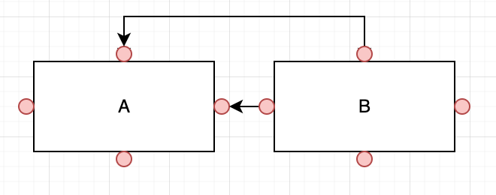
CONSTRAINTS OVERVIEW

Slide 8
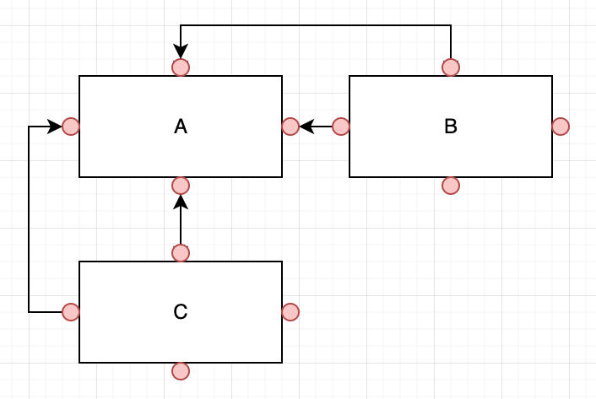
CONSTRAINTS OVERVIEW (CONT.)

Slide 9
CONSTRAINTS POSITIONING
4 Constraints for Each View
1 Horizontal & 1 Vertical Required
Views Rendered at Position [0, 0] (Top-Left Corner) for Without Constrained Views

Slide 10
DEPENDENCY
implementation("androidx.constraintlayout:constraintlayout-compose:1.1.0")

Slide 11
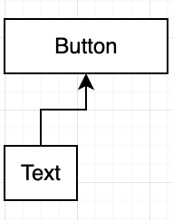
EXAMPLE
ConstraintLayout {
val (button, text) = createRefs()
Button(
onClick = { },
modifier = Modifier.constrainAs(button) {
top.linkTo(parent.top, margin = 16.dp)
}
) { Text(“Button") }
Text("Text",
Modifier.constrainAs(text) {
top.linkTo(button.bottom, margin = 16.dp)
}
)
}

Slide 12
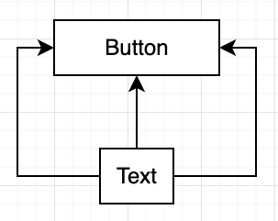
EXAMPLE 2
Button(
onClick = { },
modifier = Modifier.constrainAs(button) {
top.linkTo(parent.top, margin = 16.dp)
}
) { Text(“Button") }
Text("Text",
Modifier.constrainAs(text) {
top.linkTo(button.bottom, margin = 16.dp)
start.linkTo(button.start)
end.linkTo(button.end)
}
)

Slide 13
EXCERCISE 1
Create an Android application to render the items as designed in the following image with ConstraintLayout
(Hint: Box for Item Layout with Border)

Slide 14
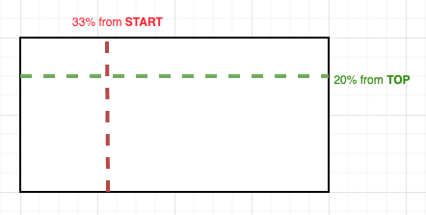
GUIDELINES
ConstraintLayout {
val startGuideline = createGuidelineFromStart(0.33f)
Val topGuideline = createGuidelineFromTop(0.2f)
}

Slide 15
GUIDELINE (CONT.)
ConstraintLayout {
// Create guideline from the start of the parent at 10% the width of the Composable
val startGuideline = createGuidelineFromStart(0.1f)
// Create guideline from the end of the parent at 10% the width of the Composable
val endGuideline = createGuidelineFromEnd(0.1f)
// Create guideline from 16 dp from the top of the parent
val topGuideline = createGuidelineFromTop(16.dp)
// Create guideline from 16 dp from the bottom of the parent
val bottomGuideline = createGuidelineFromBottom(16.dp)
}

Slide 16
EXCERCISE 2
Create an Android application to render the items as designed in the following image with ConstraintLayout
The margin between the items and the parent is 16dp
The width between the item A and B is half of the screen width
The height of each item is half of the screen height

Slide 17
CHAIN
“A chain is a group of views that are linked to each other with bi-directional position constraints. The views within a chain can be distributed either vertically or horizontally.”

Slide 18
CHAIN MODE
Spread
Spread Inside
Weighted
Packed

Slide 19
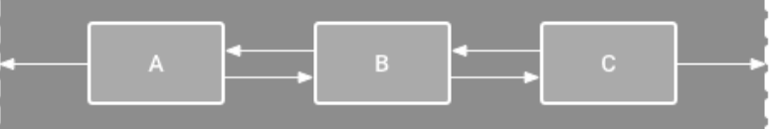
CHAIN - SPREAD
“The views are evenly distributed after margins are accounted for”

Slide 20
CHAIN - SPREAD (CONT.)
ConstraintLayout(modifier = modifier.fillMaxSize()) {
val (text1, text2, text3) = createRefs()
createHorizontalChain(text1, text2, text3, chainStyle = ChainStyle.Spread)
Text("A", modifier = Modifier.constrainAs(text1) {
top.linkTo(parent.top, margin = 16.dp)
}.size(80.dp).wrapContentSize(Alignment.Center))
Text(“B”, modifier = Modifier.constrainAs(text2) { … }
Text(“C”, modifier = Modifier.constrainAs(text3) { … }
}

Slide 21
CHAIN - SPREAD (CONT.)

Slide 22
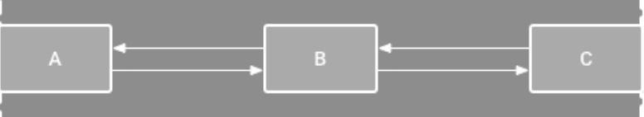
CHAIN - SPREAD INSIDE
“The first and last views are affixed to the constraints on each end of the chain, and the rest are evenly distributed”

Slide 23
CHAIN - SPREAD INSIDE (CONT.)
ConstraintLayout(modifier = modifier.fillMaxSize()) {
val (text1, text2, text3) = createRefs()
createHorizontalChain(text1, text2, text3, chainStyle = ChainStyle.SpreadInside)
Text("A", modifier = Modifier.constrainAs(text1) {
top.linkTo(parent.top, margin = 16.dp)
}.size(80.dp).wrapContentSize(Alignment.Center))
Text(“B”, modifier = Modifier.constrainAs(text2) { … }
Text(“C”, modifier = Modifier.constrainAs(text3) { … }
}

Slide 24
CHAIN - SPREAD INSIDE (CONT.)

Slide 25
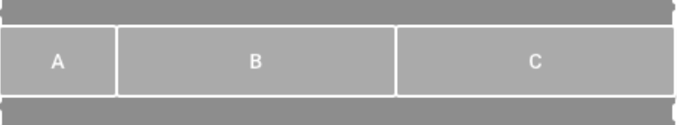
CHAIN - WEIGHTED
“With Spread or Spread Inside, weight can be set to specify the size of the view to take up all of the available space”

Slide 26
CHAIN - WEIGHTED (CONT.)
ConstraintLayout(modifier = modifier.fillMaxSize()) {
val (text1, text2, text3) = createRefs()
createHorizontalChain(text1, text2, text3, chainStyle = ChainStyle.Spread)
Text("A", modifier = Modifier.constrainAs(text1) {
horizontalChainWeight = 1f
width = Dimension.fillToConstraints
top.linkTo(parent.top, margin = 16.dp)
}.height(80.dp).wrapContentSize(Alignment.Center))
Text(“B”, modifier = Modifier.constrainAs(text2) { horizontalChainWeight = 2f }
Text(“C”, modifier = Modifier.constrainAs(text3) { horizontalChainWeight = 3f }
}

Slide 27
CHAIN - WEIGHTED (CONT.)

Slide 28
CHAIN - WEIGHTED CALCULATION
WEIGHT (A) = 1
SIZE (A) = 1 / 6
WEIGHT (B) = 2
SIZE (B) = 2 / 6
WEIGHT (C) = 3
SIZE (C) = 3 / 6
TOTAL WEIGHT = 1 + 2 + 3 = 6

Slide 29
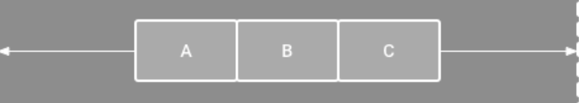
CHAIN - PACKED
“The views are packed together after margins are accounted for.”

Slide 30
CHAIN - PACKED (CONT.)
ConstraintLayout(modifier = modifier.fillMaxSize()) {
val (text1, text2, text3) = createRefs()
createHorizontalChain(text1, text2, text3, chainStyle = ChainStyle.Packed)
Text("A", modifier = Modifier.constrainAs(text1) {
start.linkTo(startGuideline)
top.linkTo(parent.top, margin = 16.dp)
}.size(80.dp).wrapContentSize(Alignment.Center))
Text(“B”, modifier = Modifier.constrainAs(text2) { … }
Text(“C”, modifier = Modifier.constrainAs(text3) { … }
}

Slide 31
CHAIN - SPREAD (CONT.)

Slide 32
EXCERCISE 3
Create an Android application to render the items as designed in the following image with ConstraintLayout
Item’s Size: 80dp Weight (A) = 1 Weight (B) = 2 Weight (C) = 3

Slide 33
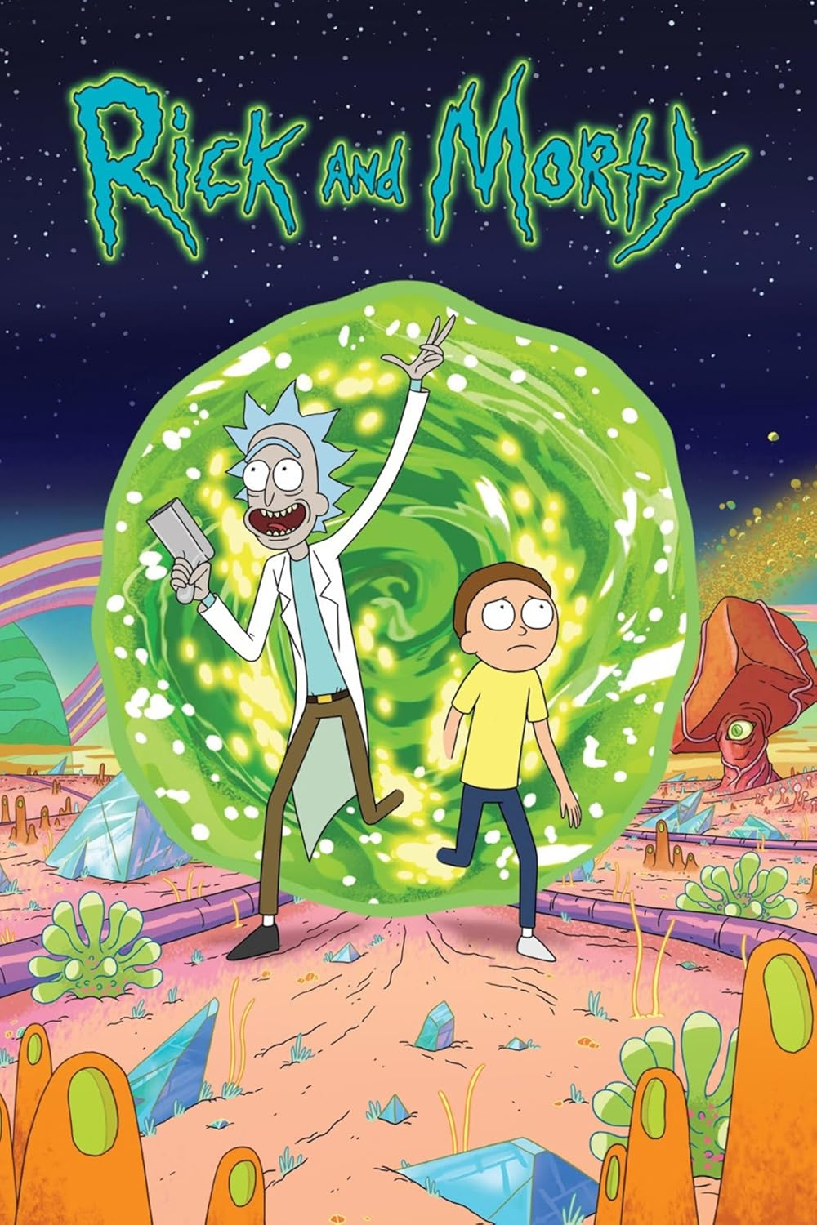
ASSIGNMENT 2
Create an Android application to show the characters in Rick and Morty based on the following design with ConstrainLayout ONLY
https://rickandmortyapi.com/api/character
File Name Format: {{COURSE}}_{{SECTION}}_Assignment_2_{{STUDENT_CODE}}
Example: CSX4109_541_Assignment_2_5510138

Slide 34
Character List
Character Detail

Slide 35
THANK YOU

